Slide 1
NTAG I²C Your entryway to NFC: The simplest, most cost-effective NFC solution
Feb, 2016

Slide 2
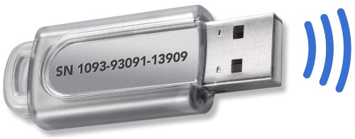
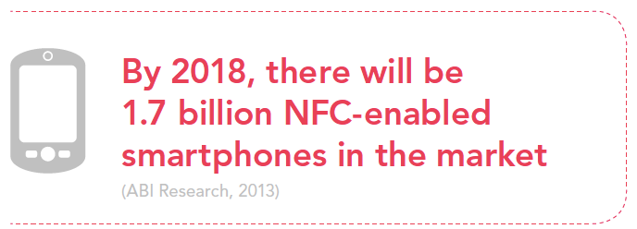
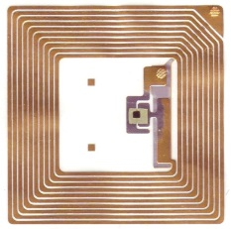

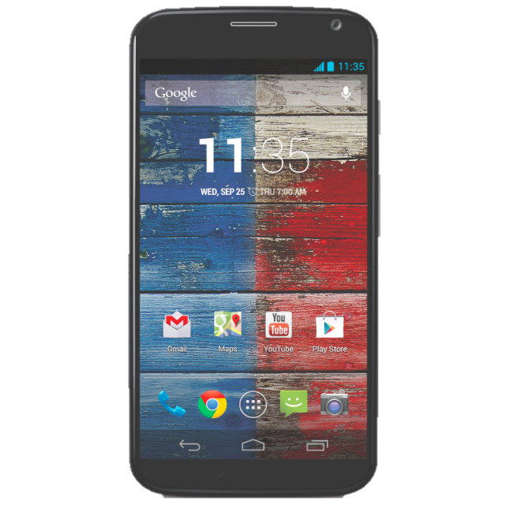

NFC | what and why?
500 million NFC-enabled smartphones shipped in 2014
NFC - like a wireless (read/write) memory stick with a unique serial number for identification
By 2018, there will be 1.7 billion NFC-enabled smartphones in the market
(ABI Research, 2013)

Slide 3
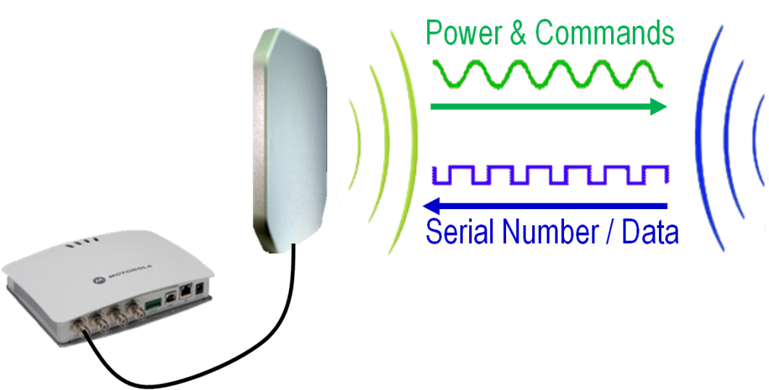
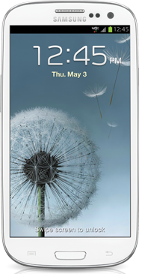
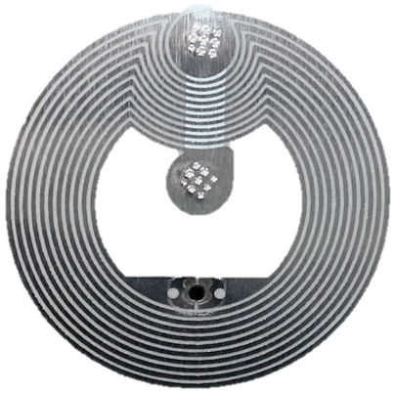
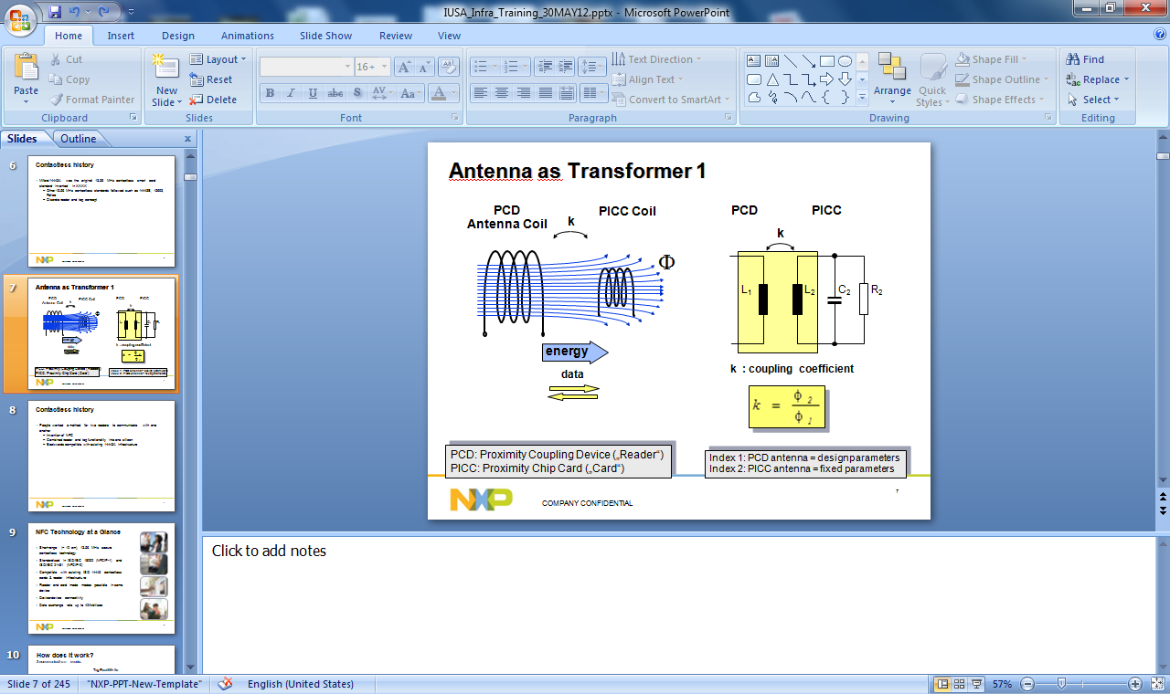
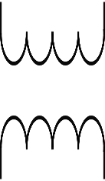
NFC | Principal of operation
Same fundamental principle as RFID, contactless smart cards or access control badges
Reader (e.g. mobile device) provides power, initiates RF communications & captures data from the tag (or programs data into the tag)
READER
13.56MHz
TAG
Like a transformer

Slide 4
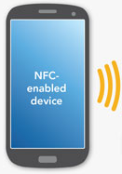
Conventional tag
Analog
NFC
Data
EEPROM

Slide 5
NTAG I²C | Connected tag - EEPROM
V_{CC}
I/F
Logic
V_{OUT}
Analog
Harvested power
SRAM
NFC
Microcontroller
FD
Interrupt
Data
EEPROM
Data
(1KB)
I²C
Serial data
GND

Slide 6
NTAG I²C | Connected tag – SRAM buffer
V_{CC}
I/F
Logic
V_{OUT}
Analog
Harvested power
Data
SRAM
Data
NFC
Microcontroller
FD
Interrupt
EEPROM
(1KB)
I²C
Serial data
GND

Slide 7
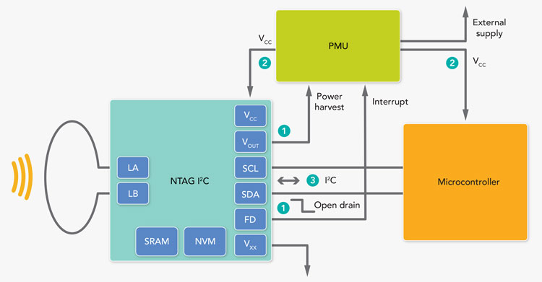
NTAG I²C | Detailed architecture
For power management, the whole system may be powered up upon Field Detection
FD is asserted low when the field is detected; PMU receives interrupt, switches V_{CC} on NTAG and µC; µC activates I²C
Alternatively, V_{OUT} (harvested energy) may be used for low power devices as source of power.

Slide 8
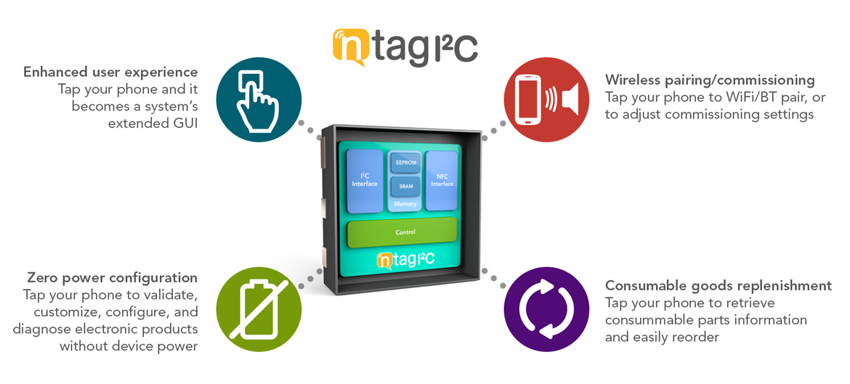
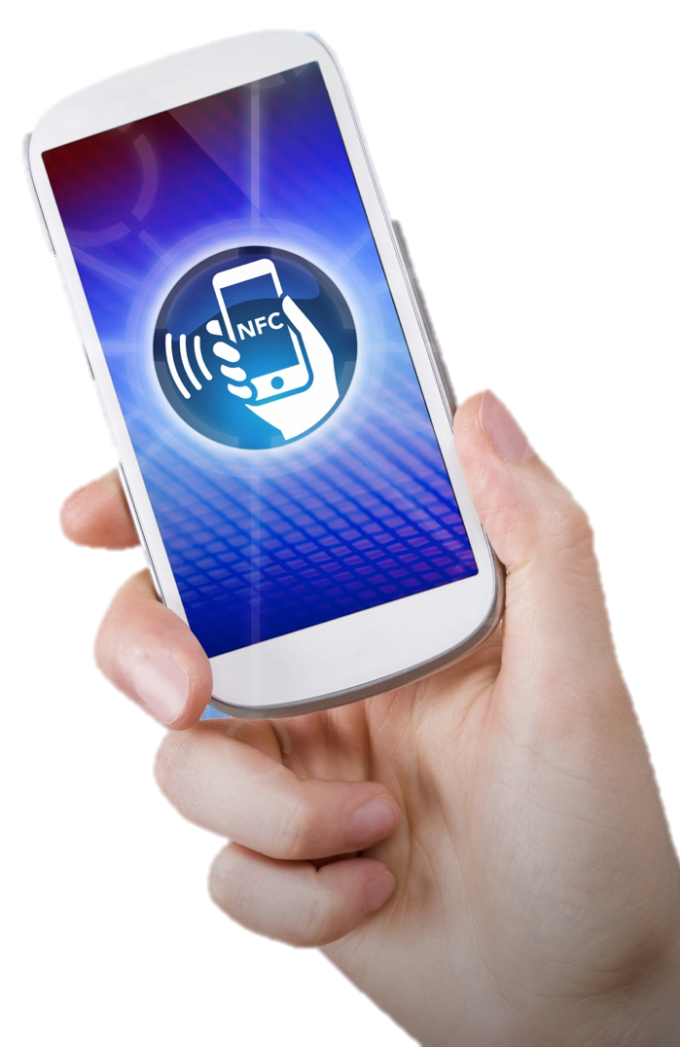
NTAG I²C | NFC for embedded applications
Notes:
Key attributes:
Zero power operation – configure without applying power or read diagnostics when the unit is inoperable
Enhance the user experience by using the NFC enabled Smart Phone for the touchscreen and network connectivity, providing a right GUI with minimal impact to the product cost
Easy pairing an commissioning to wireless networks
When consumables are required, load the tag with trusted eRetailer URLS for authenticated replenishment

Slide 9
NTAG I²C | Key attributes at a glance
Improved registration response
Automate warranty card registrations (seconds vs. minutes, uptick in marketing value)
Remote user interface
Extended a rich user interface on a NFC mobile phone without the cost of a touch display
Easy pairing & connectivity
Provide cost effective wireless connectivity or complement BT / WiFi connectivity with easy pairing
New revenue options
Open an avenue for authenticated consumable replenishments (new revenue stream for original or preferred partner branded consumables)
Wireless configuration & customization
Enable wireless product configuration, including optional upgrades from a generic board
Customize and personalize products to add a special touch
Enhanced maintenance
Electronic serialization
Improve maintenance (elaborate on error codes, provide diagnostics, enable service videos & manuals, etc.)
Easily schedule service (automate service requests, provide vital info, born-on date, & provide diagnostics)
Enable service technicians to wirelessly calibrate or download firmware without LAN or WiFi connectivity
Access appliance info/diagnostic codes/service history, even without power

Slide 10

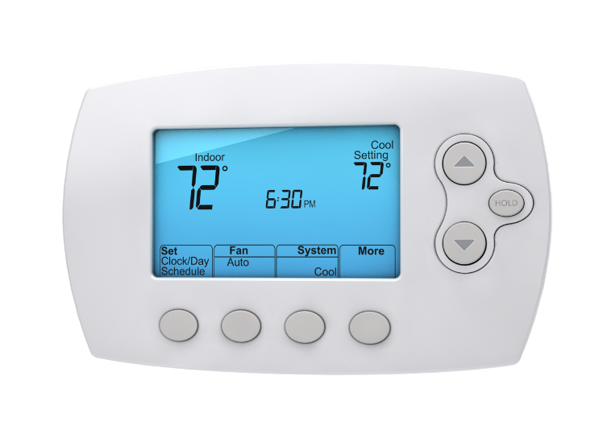
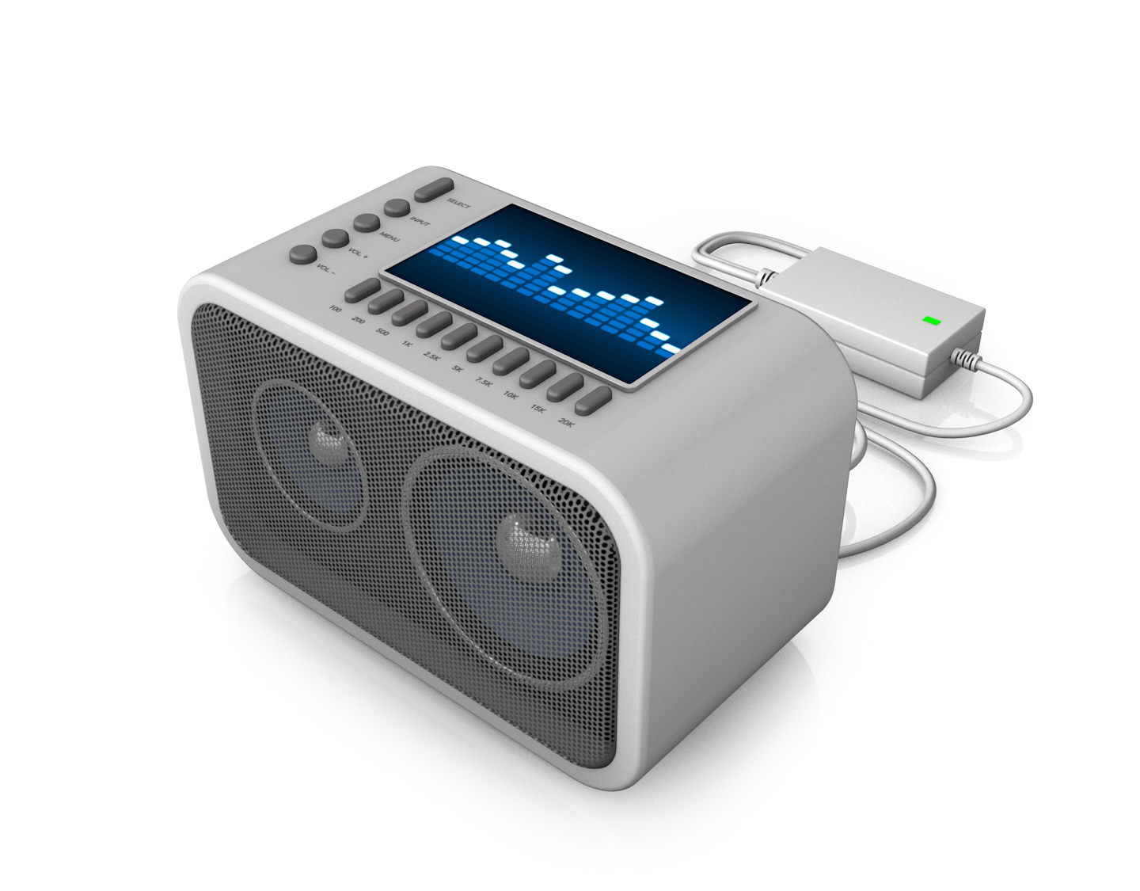
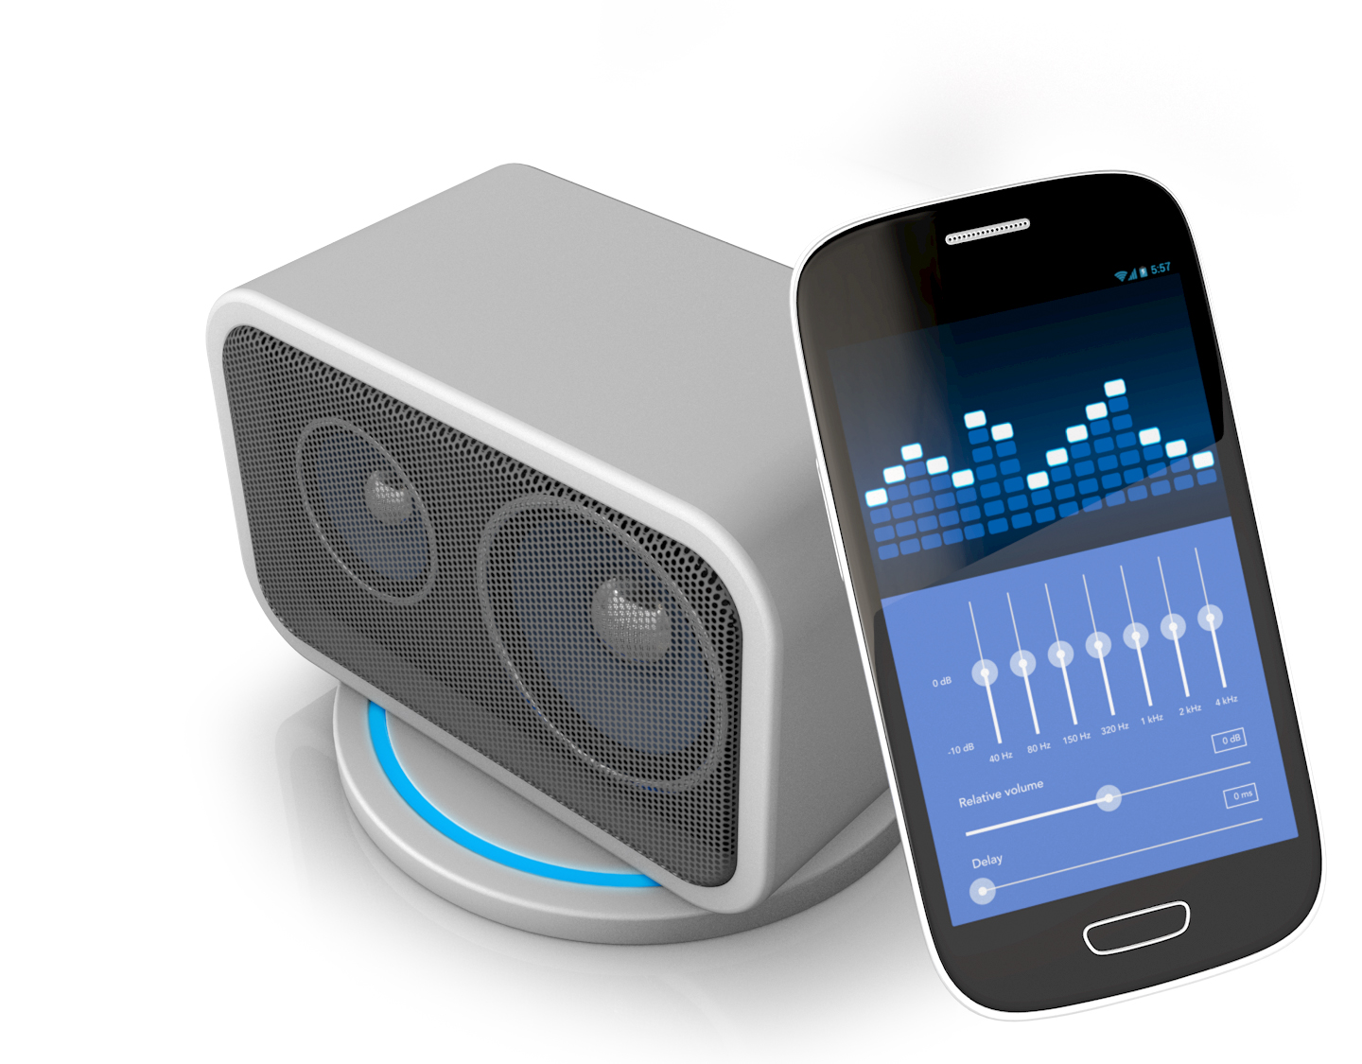
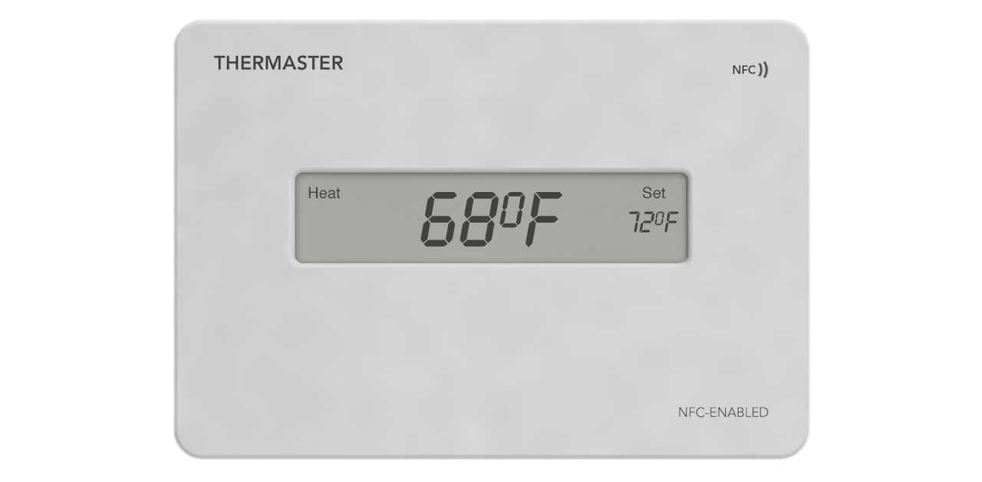
NTAG I²C enables
HIGH-END FEATURES…
AT MASS MARKET PRICES

Slide 11
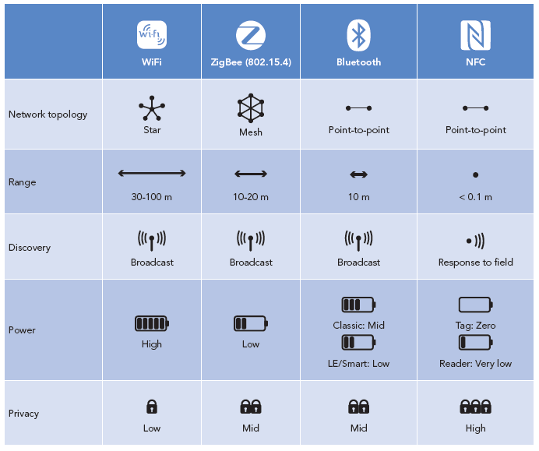
NFC | complementary to other wireless options
NFC Benefits
Pair by intent:
NFC reader initiates communication versus broadly broadcasting
Low-power:
NFC transponder (tags) harvest energy from reader field, no batteries required
Cost:
Hi feature set, low BoM cost

Slide 12
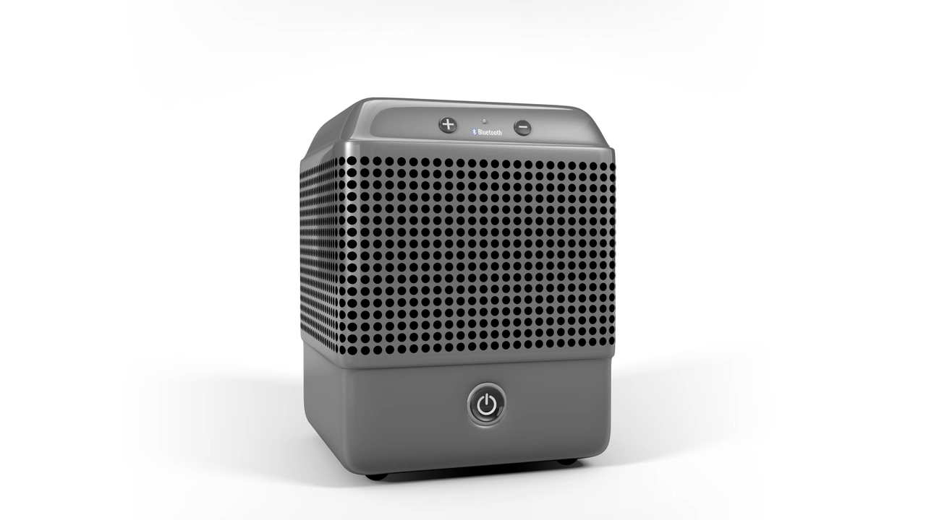
Convenient activation / pairing
Auto power / pair
Use Field Detect
Tap to power
Tap for user-friendly mobile device pairing
Easily pair to intended item where multiples may exist

Slide 13
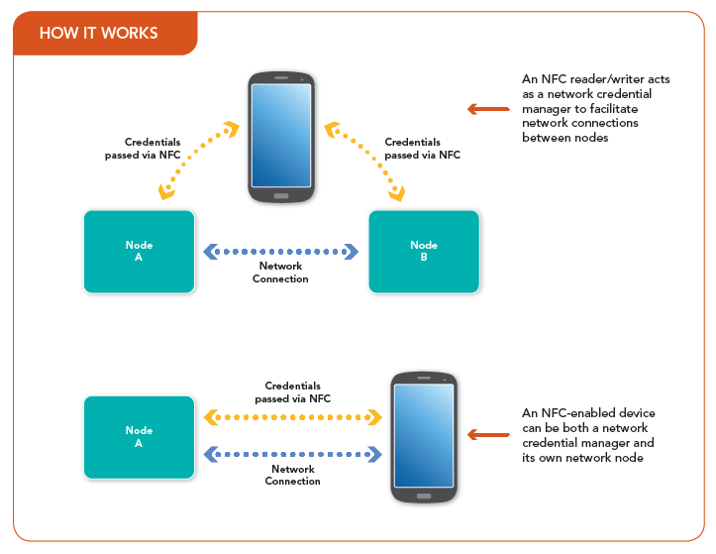
NTAG I²C Use Case – Wireless commisioning
Notes:
Use the phone to transfer network credentials – tap on the wireless router to extract the SSID/PW and again on the extender or end node to transfer the credential
Helps alleviate open broadcast security issues associated with traditional WPS methods of pairing

Slide 14
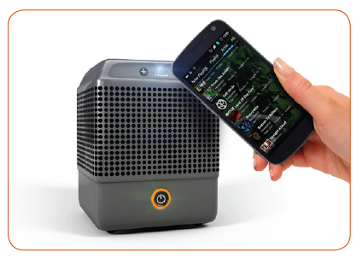
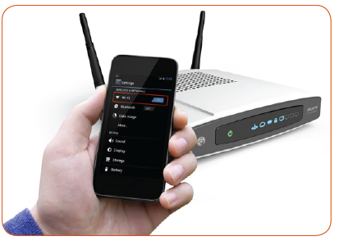
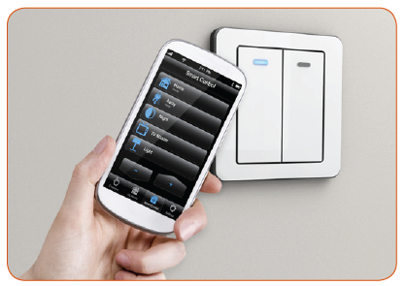
NTAG I²C Use Case – Wireless Pairing
Bluetooth Pairing
WiFi Pairing
Home automation commissioning
Notes:
As noted on slides – for commissioning and pairing

Slide 15

Learn more – tap icon below

Slide 16

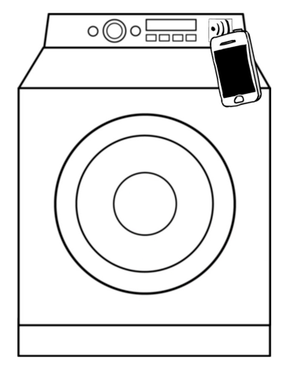
NTAG I²C | Washing machine animation
Notes:
Animation of various use cases for an appliance

Slide 17

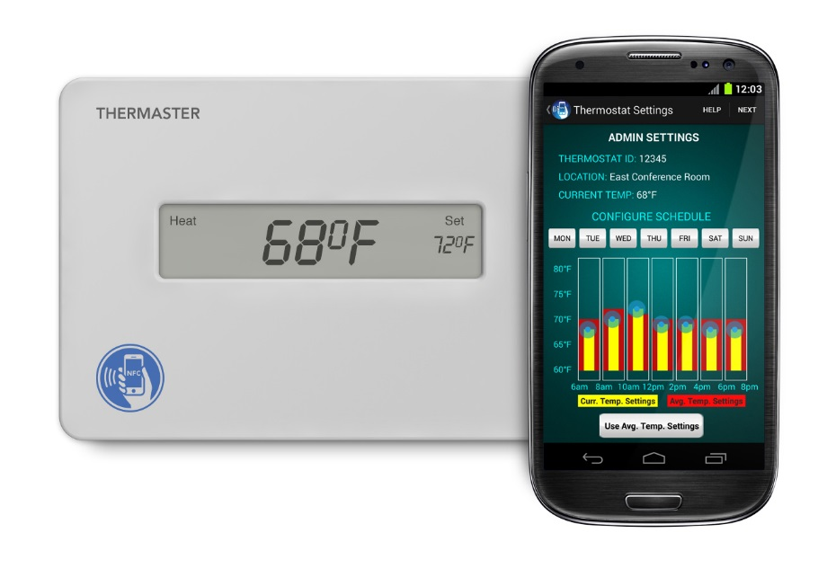
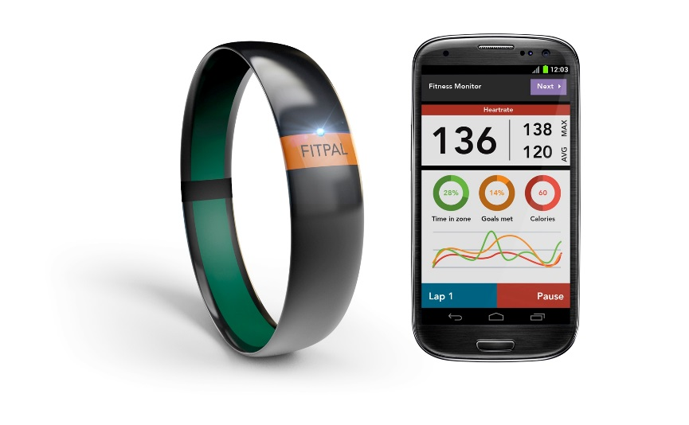

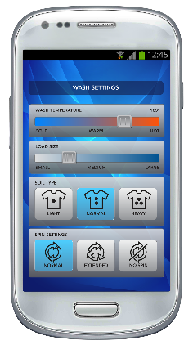
Extended product features
Enhanced feature set
Add richly enhanced product features using mobile device as extended GUI
Define and assign “favorite” user settings
Notes:
As noted on slide

Slide 18
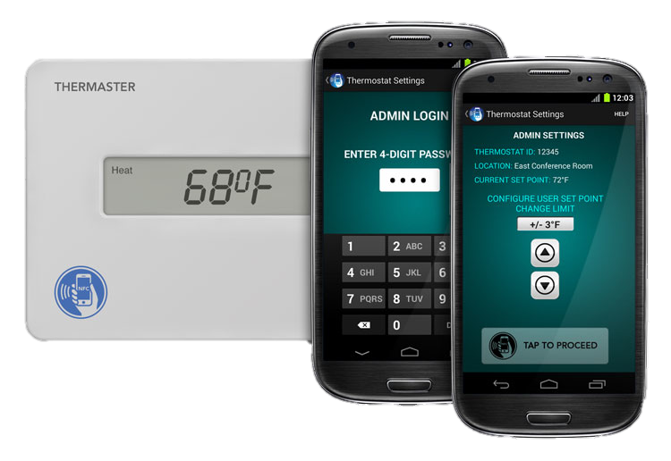
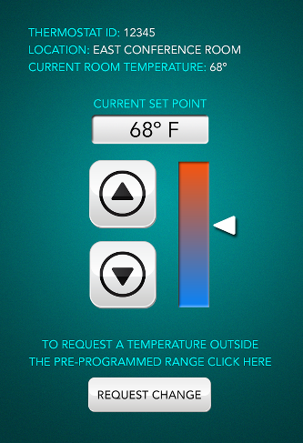
Administrative access
User-defined access
Set for administrative or general user access
Enhance security by limiting unauthorized settings
Remotely grant temporary access provisions
Notes:
As noted on slide

Slide 19


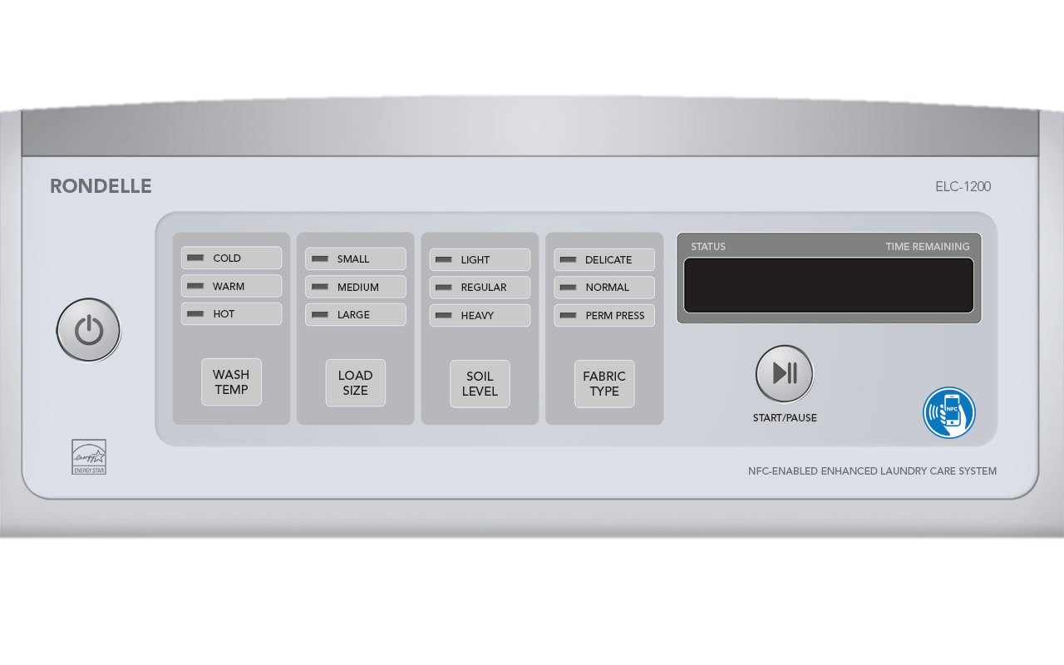
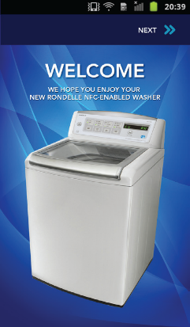
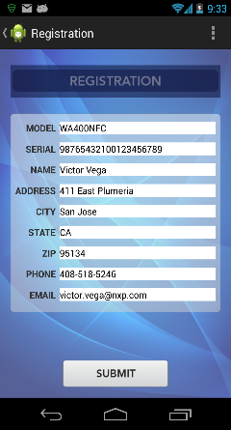
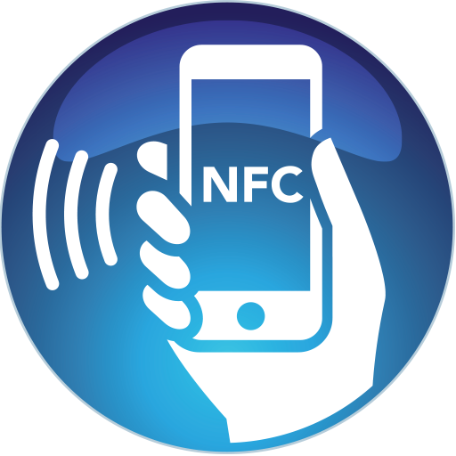

Easy registration & convenient replenishment
Easy registration
Tap to extract model/serial number
Auto-fill personal info
Electronically submit to cloud
Link opportunity for consumable replenishment
Notes:
Tap device for the serial and model number
Auto-fill with your personal info, stored in your phone, submit to register within seconds
Tap again to transfer your registration info and date into the device for warranty purposes
Link customer to cloud based eRetailers for authentic replenishments

Slide 20
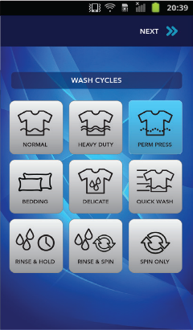
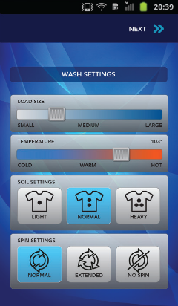
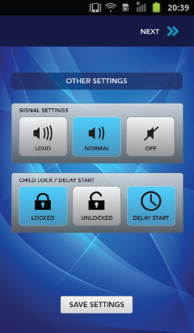
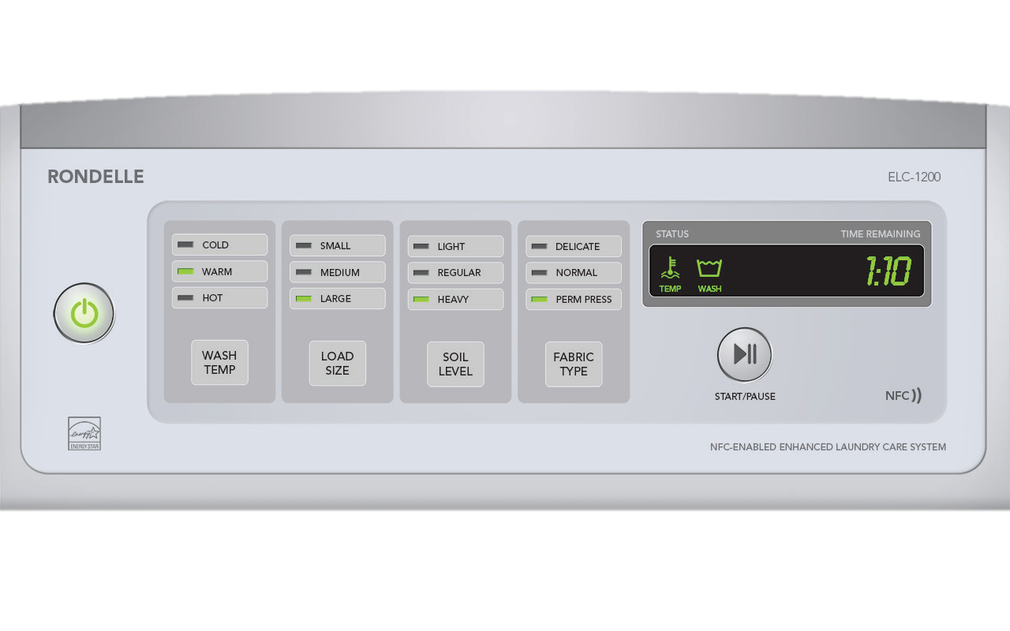
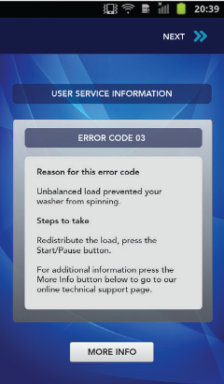
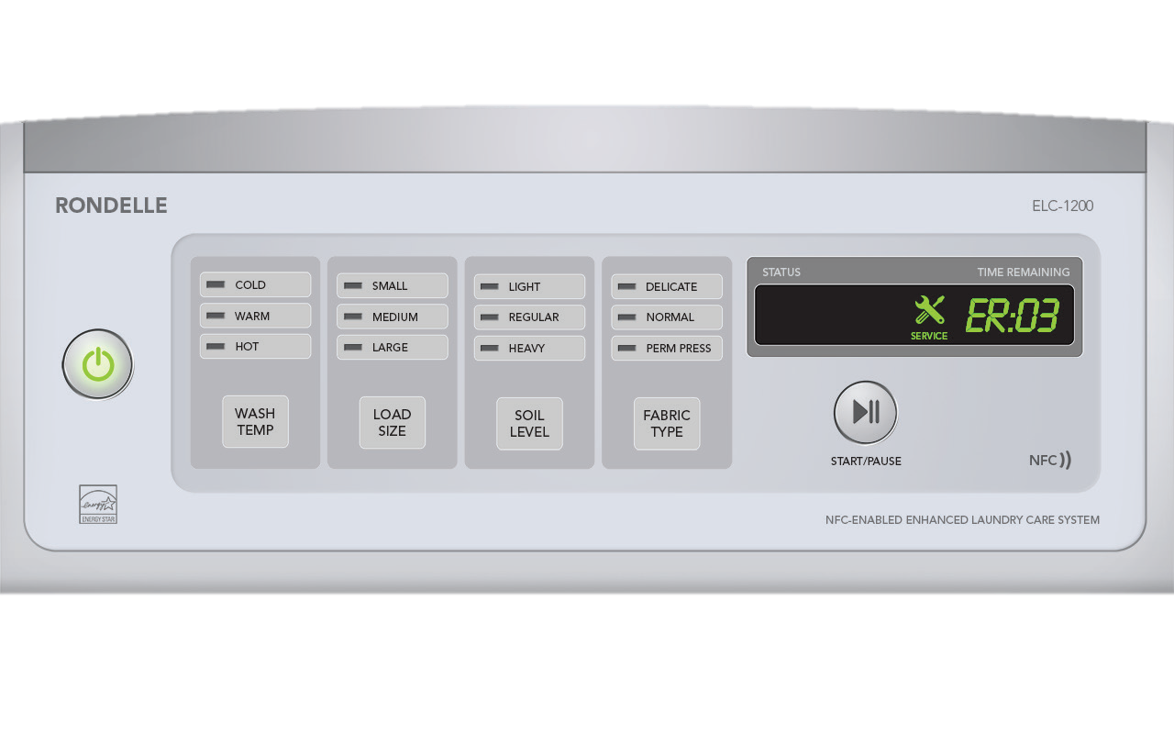

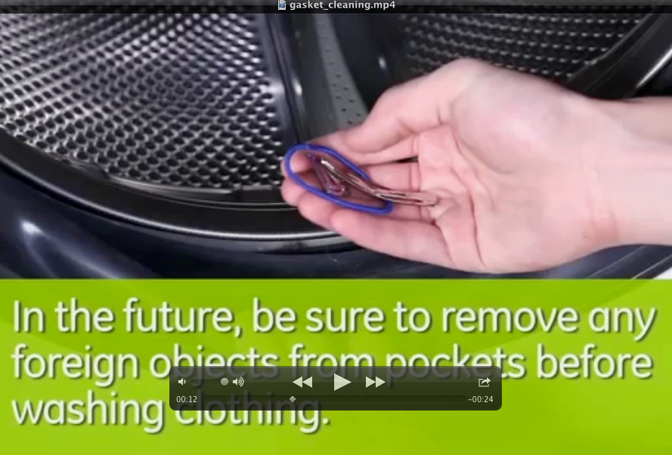
NTAG I²C Demo | Washing Machine Use-Cases
Extended user interface / features
User-friendly service
Notes:
Extended GUI elaborated
Instructional videos or manuals can be downloaded after reading the error code and model number, then looking up in the cloud

Slide 21

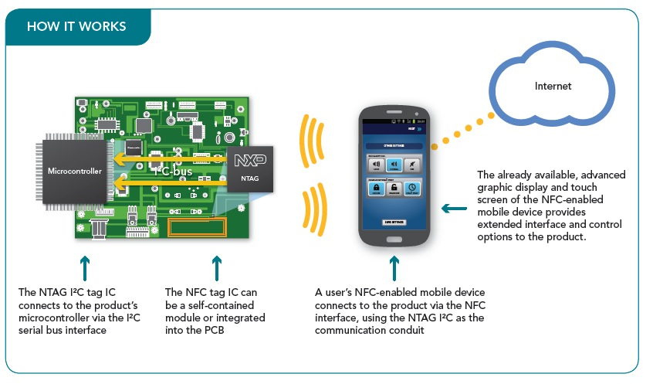

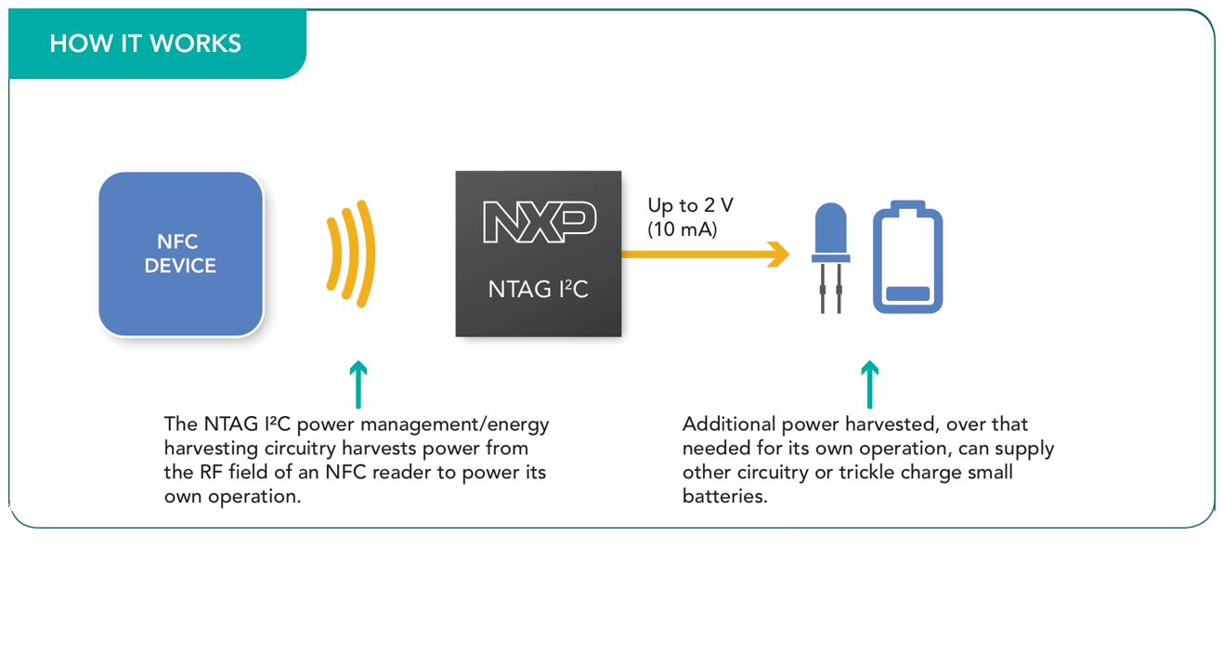
Zero-power configuration
Bidirectional communication
Configuration / calibration
Fewer production derivatives
Higher supply flexibility
Service diagnostics & contactless calibration
Notes:
Typically can provide up to about 10mW of power, e.g. 2.7V at about 3.5mA or 2V at about 5mA)
Great for powering low power micro for diagnostics or for customization or configuration without external power

Slide 22
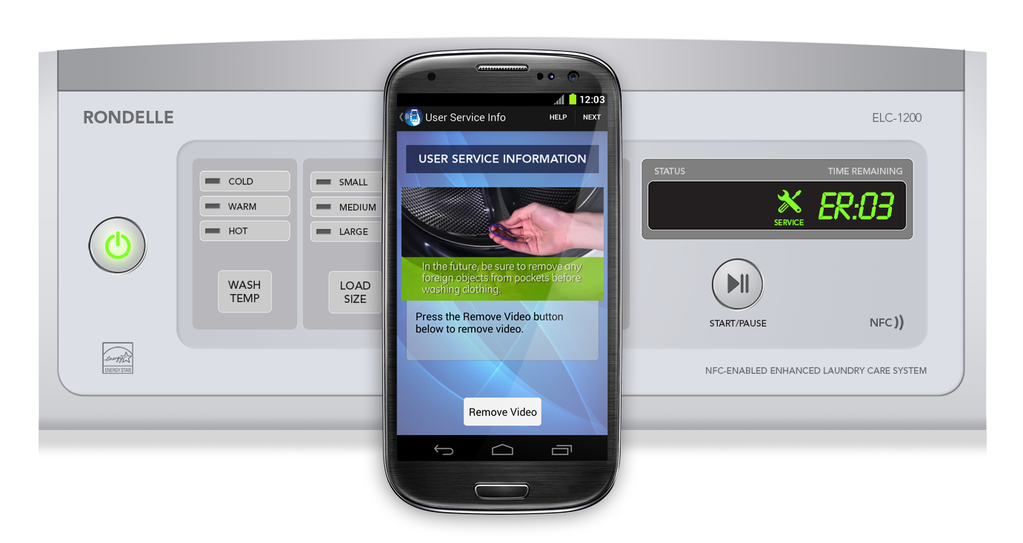
Self-serve maintenance
Convenient maintenance & diagnostics
User-friendly service references / tips / videos
Extract error diagnostics & provide helpful interactive user service hints
Notes:
As noted on slide

Slide 23
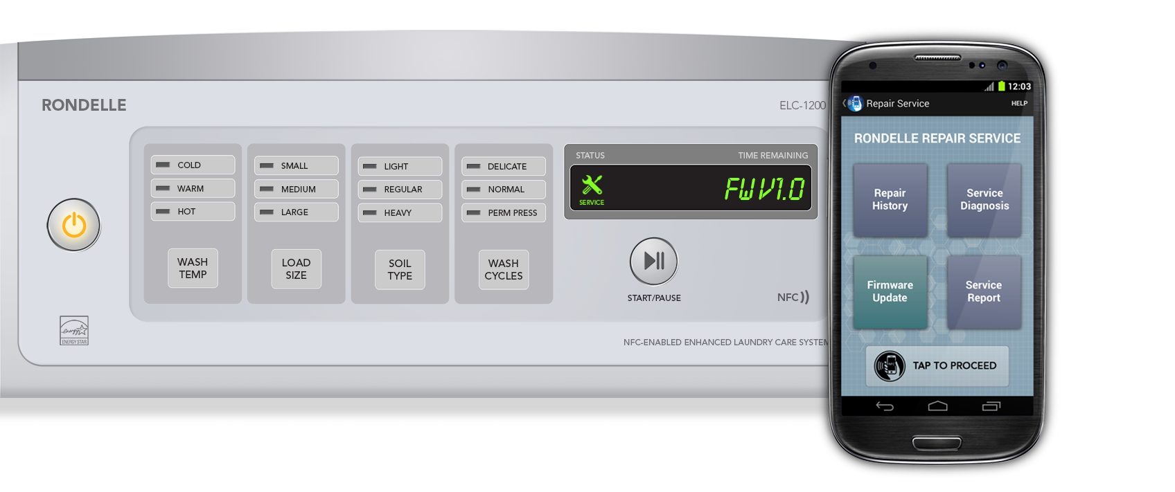
Firmware update
Bridge- mode
NTAG I²C serves as a modem, using SRAM buffer
Unlimited data exchange & unlimited write cycles
Eliminated connectors & ease machine access
Notes:
As note on slide – no limitations on on files size with SRAM buffer and no limited write cycle concerns.

Slide 24
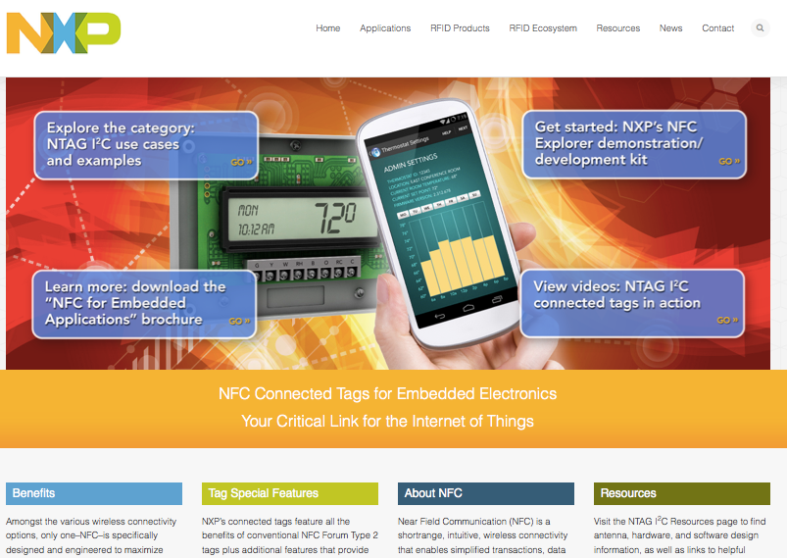
NTAG I²C website | www.nxp-rfid.com/ntag-i2c
Notes:
Plentiful design resources available for Use-Case and Application reference as well as for cut-and-paste designs

Slide 25
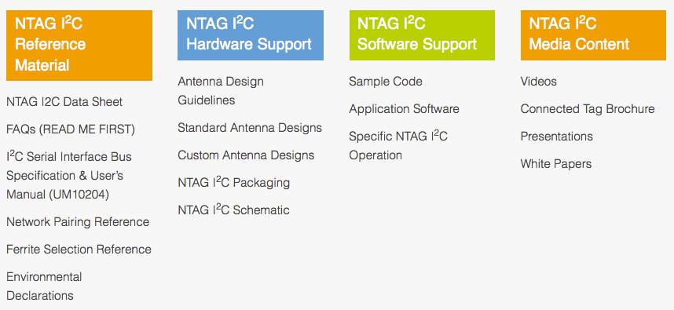
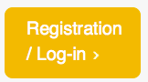
Resources | General NTAG I²C
Notes:
The general resource section include FAQ’s, the data sheet, antenna design guidelines, videos, a brochure and presentations for registered user’s to access

Slide 26
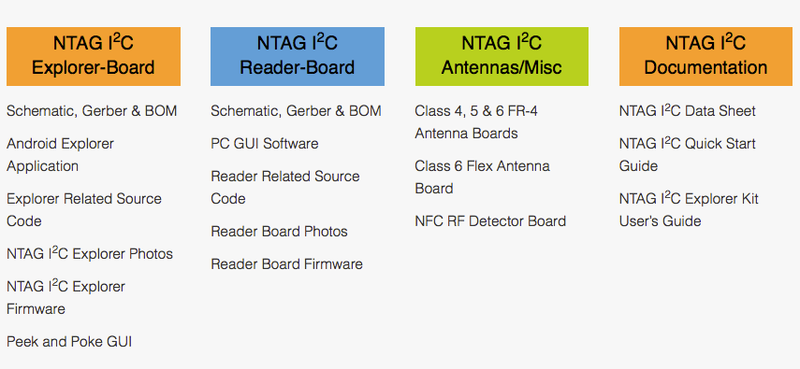
Reference Designs | NTAG I²C Explorer Kit
Notes:
The NTAG I2C Explorer Kit Reference Design include design files for the Explorer Board, the various antennas, etc.
Files include Schematics, Gerbers, BoM’s, firmware, Source Code, and an extensive user’s guide for a detailed overview of the reference design
Though the Reference Design is not readily available for purchase or sampling, the designs are available and help in importing to your application
The LED Demo is a scaled version (e.g. without a LCD display) and is readily available through the eSample desk – see your distribution representative for additional information

Slide 27
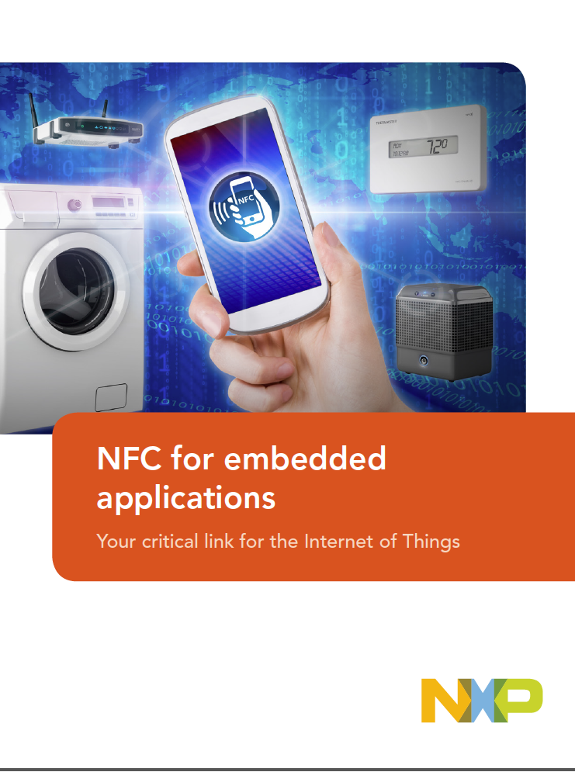
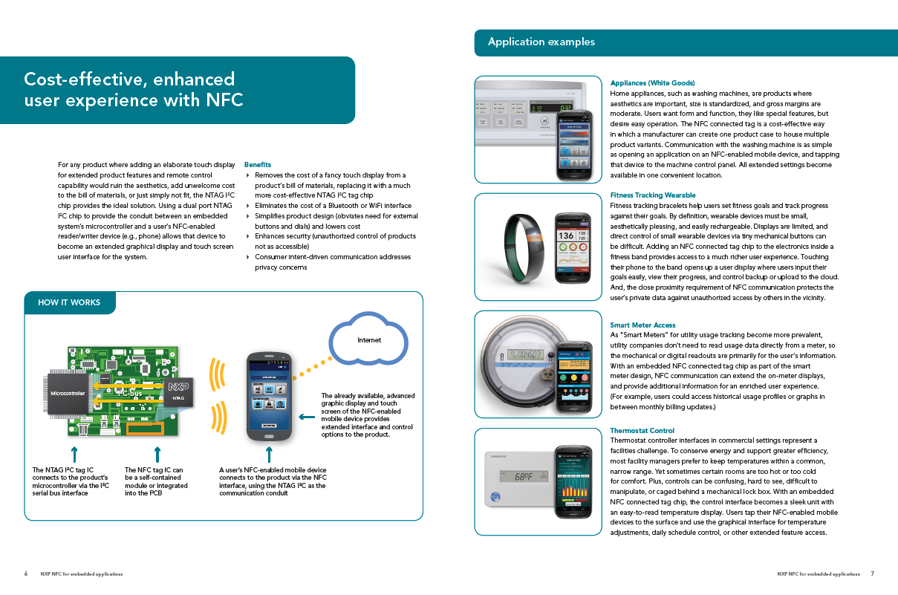
Resources | NTAG I²C Brochure
20-page brochure outlining applications, use-cases, features and benefits

Slide 28


NTAG I²C LED demo kit (OM5569/NT312D)
Contents:
LED demo board
Class 5 antenna board
(10) 1KB NTAG I2C samples
Available through eDemoboard page
Reference:
http://www.nxp.com/demoboard/OM5569.html
Notes:
Here’s the available demo kit including a LPC 812 micro, a LM75 Temp Sensor, LED’s, momentary switches ,and the NTAG I2C.

Slide 29
NTAG I²C | LED Demo – RF ➔ I²C direction
RF ➔ I²C data direction
Press a color on “Board Configuration” on the app
Confirm RGB LED on LED Demo illuminates
Notes:
Simple instructions on how to use the LED demo – showing the RF to I2C direction

Slide 30
NTAG I²C | LED Demo – I²C ➔ RF direction
I²C ➔ RF data direction
Press a numbered switch on the LED Demo Board
Confirm the appropriate numbered rectangle on the app illuminates
Notes:
Simple instructions on how to use the LED demo – showing the I2C to RFdirection

Slide 31
NTAG I²C | LED Demo Temperature
Temperature
The LM75A temp sensor provides temperature in °C to the app via SRAM
The app calculates the temp and displays it in °F
Notes:
Simple instructions on how to use the LED demo – showing the SRAM feature by reading temp

Slide 32


NXP Connected Tags | Product offerings
Product Type | NT3H1101W0FHK | NT3H1101W0FTT
Description | NTAG I²C 1KB | NTAG I²C 1KB
Delivery Form | SOT902 | TSSOP8
Sales 12NC | 9353 028 42125 | 935 305 481 118
MOQ | 4kpcs | 2.5kpcs
Notes:
Here are the min order quantity and available orderable packages of the NTAG I2C

Slide 33
Summary
NFC is becoming ubiquitous in today’s smart phones
500 million NFC enabled phones shipped in 2014
NTAG I²C connected tags enable
Feature-rich, cost effective soloutions
Passive, low power operation
Private / tap-by-intent interaction for embedded sytems
Use cases
Improved registration response
Zero-power interaction
Extended user-interface
Wireless configuration and customization
Enhanced maintenance and servicability
Resources to get started
Visit www.nxp-rfid.com/ntag-i2c for additional information
Notes:
Summary of the presentation

Slide 34
NTAG I²C plus

Slide 35


NTAG I²C vs. NTAG I²C plus
Feature | NTAG I²C | NTAG I²C plus | Comment – What is new
Backward compatibility |  |  | New features are backward compatible to NXPs NTAG 21xF family
Interoperability with NFC enabled devices | + | +++ | All features are accessible/useable via sector 0
Memory access protection via NFC interface | + | +++ | (Optional) 32-bit password to write or read & write protect (parts of) EEPROM and/or SRAM Disable NFC access at all Disable NFC access to sector 1
Memory access protection via I²C interface |  |  | Restrict access to protected area from I²C perspective to read-only or no access at all
ECC based Originality Signature |  |  | Genuine and simple authentication scheme
Pass-through performance | + | +++ | Four times higher pass-through performance due to introduced FAST WRITE command
Wave-soldering assembly |  |  | On top of XQFN8 and TSSOP8 package, we offer SO8 package
Temperature range | -40°C to 95°C | -40°C to 105°C | For industrial applications
Supply Voltage Range | 1.8V to 3.6V | 1.67V to 3.6V | For single cell supplied devices - like wearables

Slide 36

NTAG I²C plus features
NFC Forum Type 2 Tag (will be possible to certify)
Dual interface
NFC & I²C (100 & 400kHz) interface
50 pF input capacitance
Either 888 or 1912 Byte EEPROM
Energy harvesting functionality to power external device
PIN to PIN outlines & fully backward compatible
What´s NEW?
Pass Through Mode performance increased by factor 4 in NFC to I²C with FAST_WRITE command to SRAM
Authentication: Originality signature based on ECDSA (compatible with the NTAG 21x(F) family)
Access protection: Optional 32-bit password on the full EEPROM and the SRAM buffer
SO8 package & XQFN8 package (1,6*1,6*0,5mm) & TSSOP8
Increased Compatibility with legacy NFC devices (SRAM and CONFIG on sector 0)

Slide 37


NTAG I²C plus Memory Access Rights
888/1912 Byte User Memory
*: I²C Address on block 0 byte 0 only writeable, but not readable
RF Sector | Byte number within a page
Hex | 0 | 1 | 2 | 3
0h | Serial number (SNR)
 |  |  | Static lock bytes
 | Capability Container (CC)
 | User memory (888/1912 Bytes)
 | Dynamic lock bytes (3 Bytes)
 | Default Configuration (8 Bytes)
 | SRAM memory (64 Bytes) in Pass Through mode only
3h
 | Session registers (8 Bytes)
Memory
Read
Write
RF
I²C
RF
I²C
Serial Number
-
I2C
Address *
Lock Bytes / CC
OTP, Lockable
User Memory
AP
Lockable, PWD
AP
Lockable, PWD
Configuration
Lockable, PWD
Lockable
PWD
SRAM
PWD
PWD
Session Register
-
Notes:
Password protection is excluded for Dynamic lock bits, session registers and mirrored SRAM pages.

Slide 38

Special memory block: Configuration bytes
NC_REG = NTAG Control Register, controls enabled functions
SILENT MODE
PASS THROUGH MODE (now is documented and is useable)
LAST_NDEF_BLOCK: Address of end of NDEF message (FD pin trigger)
SRAM_MIRROR_BLOCK: Address of mirrored SRAM (for SRAM_MIRROR)
WDT_LS: Watchdog timer control for I²C communication (16 bit) LSB
WDT_MS: Watchdog timer control for I²C communication (16 bit) MSB
I2C_CLOCK_STR: I²C Clock Stretching
REG_LOCK: Prevent Write Access from RF / I²C
Back

Slide 39
NTAG I²C plus RF commands
The RF-interface is based on the ISO/IEC 14443 Type A standard for contactless smart cards. All memory functions are operated in the ACTIVE state.
NEW:
Proprietary (need App)
FAST_WRITE | Writes 64 bytes to SRAM (only pass-through mode)
READ_SIG | Returns IC specific 32-byte ECC signature (NXP)
PWD_AUTH | Access to protected area (AUTH0, NFC_PROT – defines protection, AUTHLIM–unsuccessful attempts)

Slide 40
Pass-through – speed test
Heavily dependant on the NFC readers used
Mobile phones typically slower than NFC readers. FAST_WRITE improved speed.

Slide 41

Energy harvesting
1
PMU
(Power Management Unit) optional, can be in the µC
3
2
NTAG I²C plus
VOUT
VCC
µController
4
SCL
LA
SDA
LB
FD
SRAM
NVM
open drain
With energy harvesting a microcontroller can be supplied with power
Typically >5mA @2V
Up to 13mA in case of strong NFC readers (not NFC phones)
Power up can be controlled by Field Detection for further power management optimization
FD goes low when field is detected; PMU receives interrupt, switches on VCC on NTAG and µC; µC starts communication on I²C
Feb-16

Slide 42

Energy harvesting – achievable power

Slide 43
Flexible Memory Access Management (1/2)
RF/NFC perspective
I²C perspective
RF/NFC perspective
32-bit password
16-bit PACK (password auth. acknowledge response)
Optionally limited number of unsuccessful authentications
up to 2⁷ negative attempts
Write or read/write memory access can be restricted to be allowed only after password authentication
Pass-through can be restricted to be allowed only after password authentication
Memory can be split in open and protected segments
Memory boundary is configurable

Slide 44
NTAG I²C plus Silent Mode
With the bit NFCS_I2C_RST_ON_OFF (NC_REG) below features are enabled the same time:
I²C soft reset
- Helps if interface gets stuck due to heavy bus interference
- „STOP“ after each start symbol mandatory
NFC silence feature
- NFC demodulator is turned off/disabled
- Tag „disappears“ even if present in the field

Slide 45
NTAG I²C plus general application circuit
VCC
R1
R2
R3
NTAG I²C plus
VOUT
VCC
SCL
µController
LA
SDA
C2
LB
FD
SRAM
NVM
EH
PMU
C1
R1 + R2 = general I²C Bus Pullup, only ONE needed per I²C bus, sized according to bus load (usually 1k-10k)
R3, FD pin pullup, use any value above ~1k (e.g.: 20k)
C1 = 100nF – 200nF (recommended). For larger caps measures to reduce the start-up-current are needed (e.g. Serial resistor of 20 Ohm between the EH pin and the first cap)
C2 – optional, only needed if resonance of antenna alone is too high – target resonce should be around 13,5-14,5 Mhz – beware of influence of surrounding!

Slide 46
NTAG I²C plus standby power saving
For RF communication the tag works completely passive – no external power needed
Power on VCC (typical 155µA) is needed only for:
I²C communication
Usage of SRAM
How to save power:
Turn VCC off unless I²C communication or SRAM is needed
MCU can detect RF activity using:
Vout – goes high in case the tag is exposed to RF field
FD pin – can be configured to go low (open drain – needs pullup) on RF activity
→ Standby power can be reduced to zero! (in case of using Vout)

Slide 47

NTAG I²C plus demokits variants OM5596/NT322(X)
Demokit name | Contents
OM5569/NT322E | NTAG I²C plus Explorer Kit with Field Detector Board, flex antenna and SO8 samples
OM5569/NT322ER | NTAG I²C plus Explorer Kit Field Detector Board, flex antenna, NFC reader and SO8 samples
OM5569/NT322F | NTAG I²C plus Flex Antenna Kit with 3 different flex antennas only and SO8 samples

Slide 48

NTAG I²C plus Explorer Board OM5569/312E
Components:
LPC11U24
RGB-LED
Buttons
Temp-Sensor LM75B
LCD
micro-USB
Shows:
Energy Harvesting
LED Demo with interactive LED control and Buttons + Temp feedback
Zero-Power Configuration (switch LED on depending on NDEF)
SRAM and EEPROM speed measurement
NDEF message read write with NDEF content display on LCD
I²C memory read/write with a windows GUI (I²C-USB-Bridge)
MCU firmware flashing via NFC
Antenna Design Files Class 4, 5, 6 + Flex
PCB Design Explorer Board + Firmware
Availability: NXP webpage

Slide 49

NTAG I²C plus - general support tools
PC-Software
RFIDDiscover Lite 4.1.5 supports NTAG I²C plus
Peek & Poke
PC App for Explorer board
Android project for Eclipse (portable to Android Studio)
NFC TagInfo by NXP (in Google PlayStore)
NXP TagWriter by NXP (in Google PlayStore)
Android: “NTAG I2C Demo” (will be available in Google PlayStore)
Controlling LEDs and showing communication speed available on Google Play store „NTAG I2C Demo“
Improved FAST_WRITE
Reading temperature from temp. sensor
Writing data to LCD
Firmware upload
Password authentication
(links active/online
mid February)

Slide 50
NTAG I2C Explorer board firmware
The delivered NTAG I²C Explorer board firmware consists of three applications:
NTAG_I²C_Explorer_Bootloader
Jumps to the start memory of the user application. Enter into Flashing mode functionality. Enter into USB mode (Peek and Poke).
NTAG_I²C_Explorer_Demo
This project implements the logic supporting the Android / Windows demonstration applications
NTAG_I²C_Explorer_Blink
This application is provided to illustrate the NFC flashing functionality

Slide 51

NTAG I²C plus Android Demo Application Screen: LEDDemo – 1.7.5 and upper
Select a LED colour which should light up on demoboard or switch off LED
Onboard temp. sensor can be enabled/disabled
LCD can be enabled/disabled as well as NDEF message appearance on LCD
Reads back:
Temperature
Energy Harvesting Voltage V_{out}
NXP logo colours changing dependent on button pressed on Demoboard

Slide 52

PC Software – PC App
Will be available from NXP
public website
Together with the USB reader, the Windows app can be utilized to substitute a missing NFC mobile phone. The Windows app has identical functionalities as the Android app.

Slide 53

PC Software – Peek & Poke
The Peek and Poke GUI is a Windows app that can be used to examine the detailed memory contents of the NTAG I²C EEPROM via I²C interface.

Slide 54
Software sources (link active/online mid February) www.nxp.com/demobaord/OM5569
Title | Link
Source files
Android app (Eclipse project, works with Android studio) source | download
PC app (c# - Visual Studio) source | download
Peek and poke sources | download
Firmware for Explorer board includes: | download
NTAG I²C PLUS API
NTAG_I²C_Explorer_Bootloader
NTAG_I²C_Explorer_Demo
NTAG_I²C_Explorer_Blink

Slide 55
NTAG I²C plus documents (link active/online mid February) http://www.nxp.com/products/NT3H2111_2211
Title | Link
Application notes
NTAG Antenna Design Guide | AN11276
NTAG21x Originality Signature Validation | AN11350
NTAG I²C Energy Harvesting | AN11578
How to use NTAG I²C (plus) for bidirectional communication | AN11579
NTAG I²C plus Memory Configuration Options | AN11786
User guides
NTAG I²C plus Explorer Kit and Android Demo | UM10966
NTAG I²C plus Explorer Kit and Peek & Poke | UM10967
*
*
*
*
*
* Available in DocStore already!

Slide 56

www.nxp.com/nfc

Slide 57
Thank You

